Slide 1
C++ Training (The Basics)
Daniel Medina

Slide 2
Daniel Medina
Software developer, married and with 2 kids
Master degree in Electronic Design Systems
~6 years of C++ development experience (Continental, Intel and personal continuous improvement)
Quality, maintainability, high performance
Notes:
Attendees introduction and how familiar are with C++

Slide 3
Index
Introduction
Software development tool set
Basic Objects
Scope
Reference vs Pointer
const
Memory Management
std reference
Google coding style

Slide 4
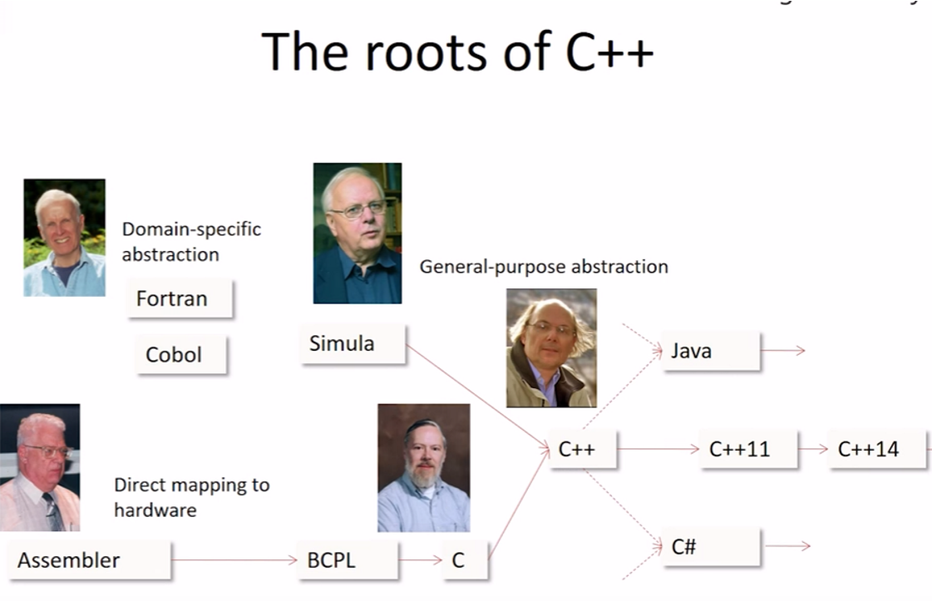

Slide 5
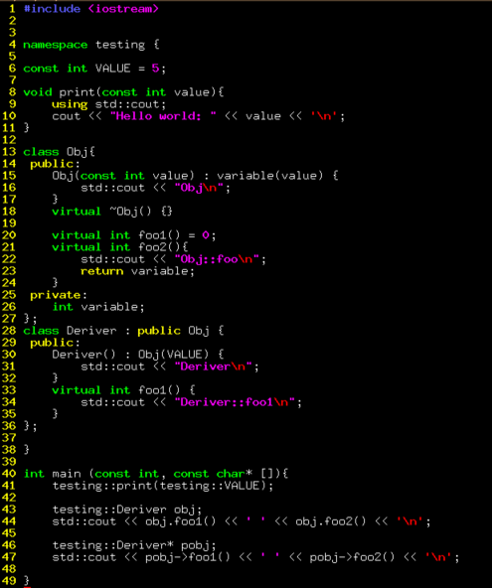
Why a C++ training?
Notes:
New team members
How many can do a hello world in 1 mins?
New C++ concepts
Why C++ and not python?
Use C++ instead of C
Whats a data type? Is a blundle of compile-time properties for an object (size, alignment, valid values, permitted operations, what can’t do)
Difference between C and C++ The fundamental concept of the type system

Slide 6
The power of C++
The fundamental of the type system
Low level memory model (like C)
Polymorphism (OOP)
Code generator machine (templates)
Notes:
The human mind can design better solutions as the language moves from the machine to a higher level

Slide 7
The logic should be straight forward to make it hard for bugs to hide,
the dependencies minimal to easy maintenance,
error handling complete according to an articulated strategy,
and performance close to optimal so as not to temp people to make the code messy with unprincipled optimizations.
Clean code does one thing well
Use Common Sense and BE CONSISTENT
- Bjarne Stroustrup

Slide 8
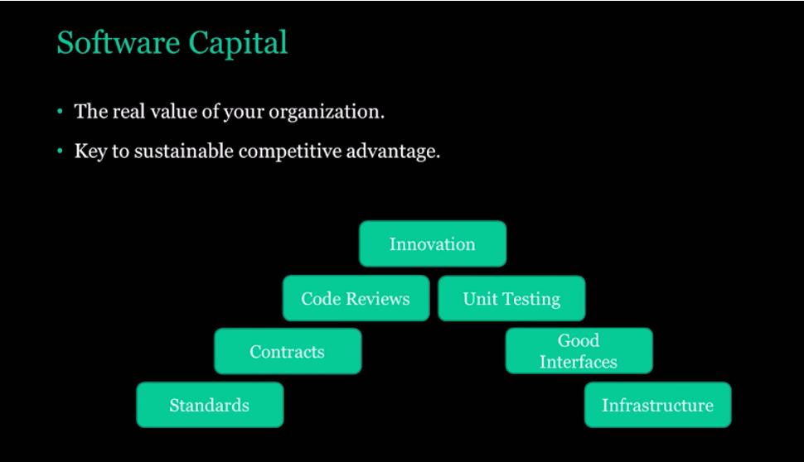

Slide 9






Software development tools

Slide 10
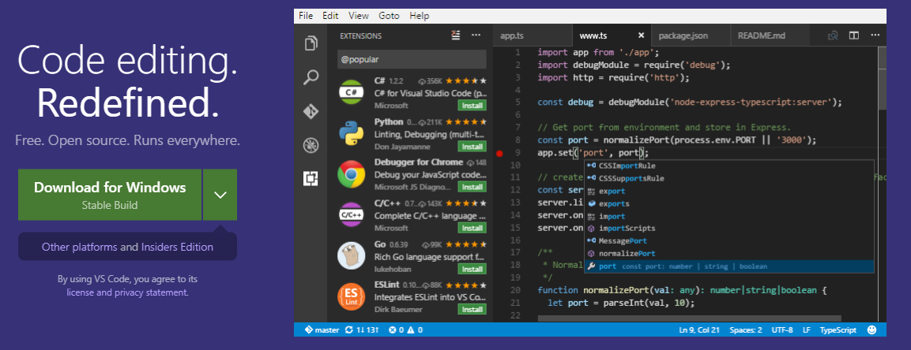
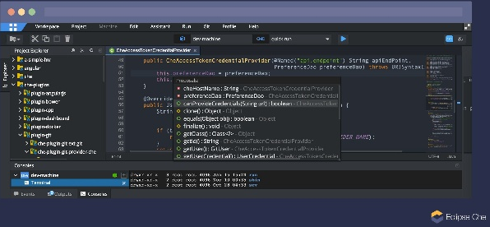
IDEs
https://code.visualstudio.com/?wt.mc_id=vscom_downloads
eclipse

Slide 11
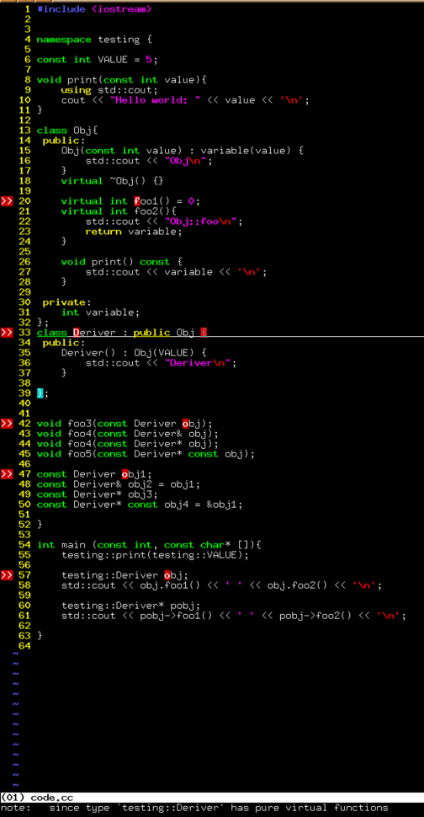
Vim (my favorite)

Slide 12
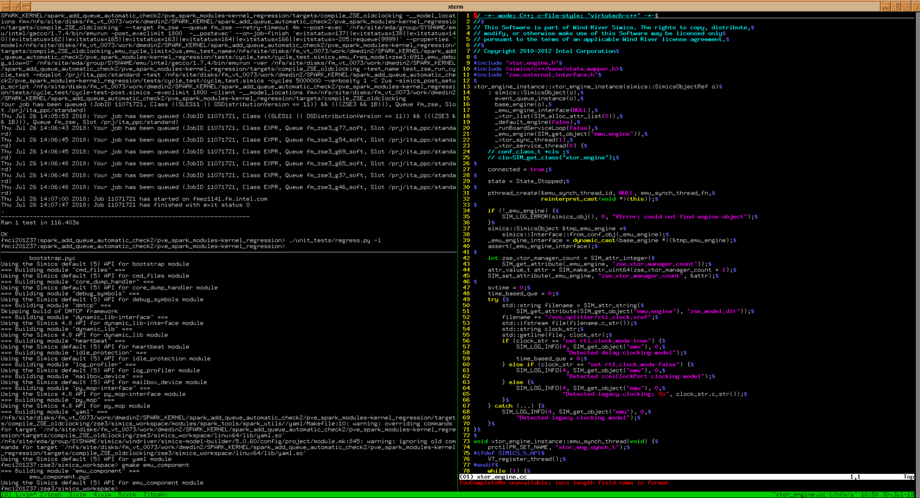
Boosted Vim (with plug ins)

Slide 13
More SW development tools
Compiler (gcc & clang)
-Wall -Wextra -pedantic -Wshadow -Wdelete-non-virtual-dtor -Wold-style-cast -Wcast-align -Wunused -Woverloaded-virtual -Wconversion -Wsign-conversion -Werror -Weffc++ -Wstrict-aliasing=2 -ansi
Clang-format
Stop doing manually format
https://clang.llvm.org/docs/ClangFormat.html

Slide 14
More SW development tools
Static analyzer
Cppcheck
clang-tidy
cpplint
Address sanitizer
Gcc & clang address analysis
Runtime analyzers
clang-safecode
valgrind

Slide 15
HomeWork
Bring your favorite IDE configured and ready for development

Slide 16
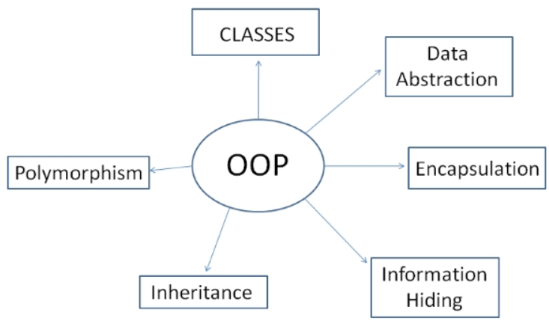
Basics Objects

Slide 17
Treat clas designs as type designs
How should objects of your new type be created and destroyed?
How should object initialization differ from object assignment?
What does it mean for objects of your new type to be passed by value?
What are the restrictions on legal values for your new type?
Does your new type fit into an inheritance graph?
What kind of type conversions are allowed for your new type?
What operators and functions make sense for the new type?
What standard functions should be disallowed?
Who should have access to the members of your new type?
What is the "undeclared interface" of your new type?
How general is your new type?
Is a new type really what you need?

Slide 18
Basics Objects and not objects
Class
Constructor, destructor
Polymorphism
Encapsulation
operators

Slide 19
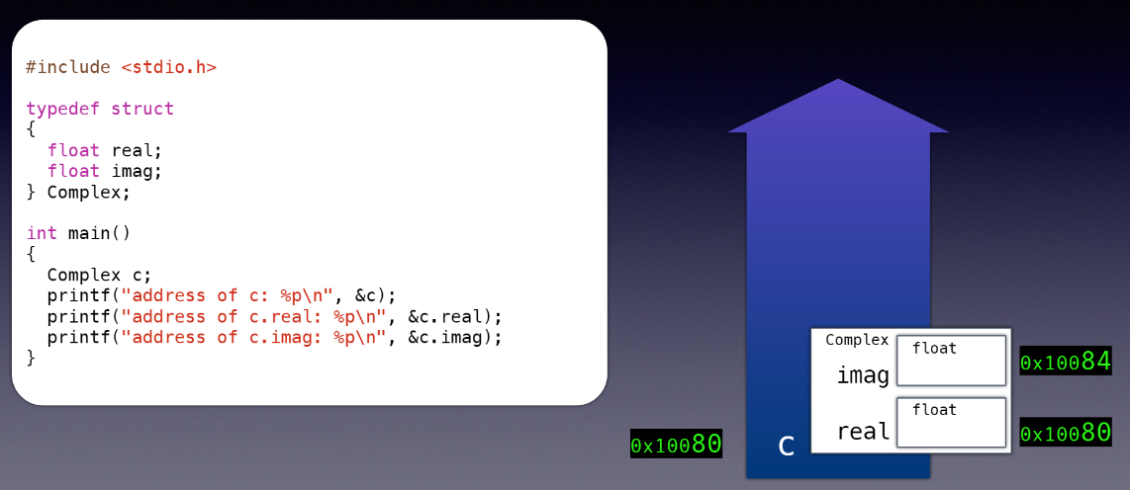
Basics Objects
Memory Model
Notes:
Whats a data type? Is a blundle of compile-time properties for an object (size, alignment, valid values, permitted operations, what can’t do)

Slide 20
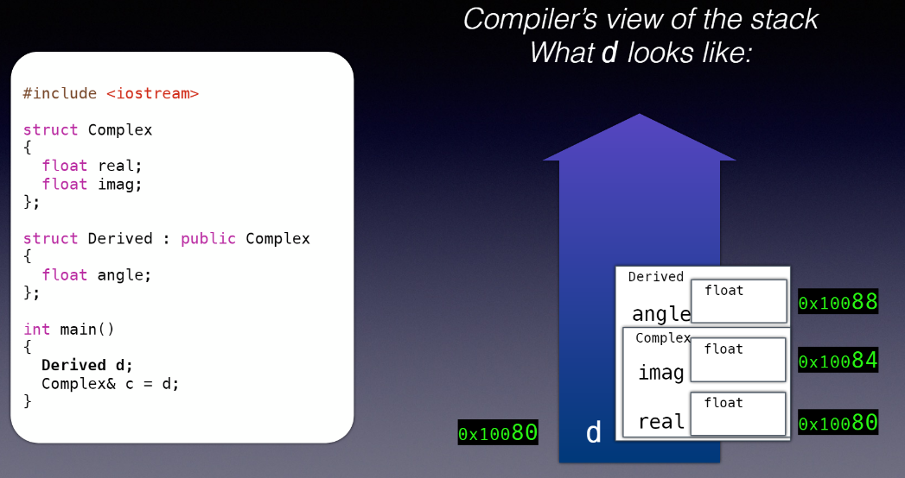

Slide 21
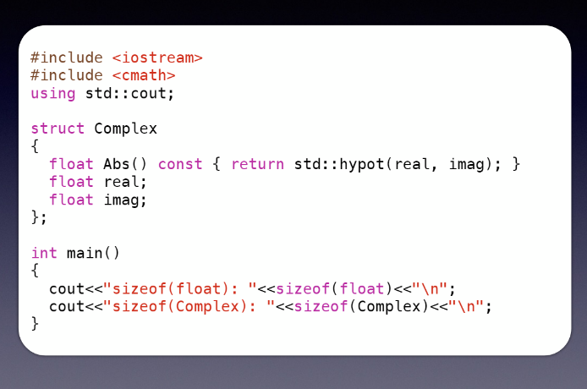
Notes:
sizeof(Complex): 8

Slide 22
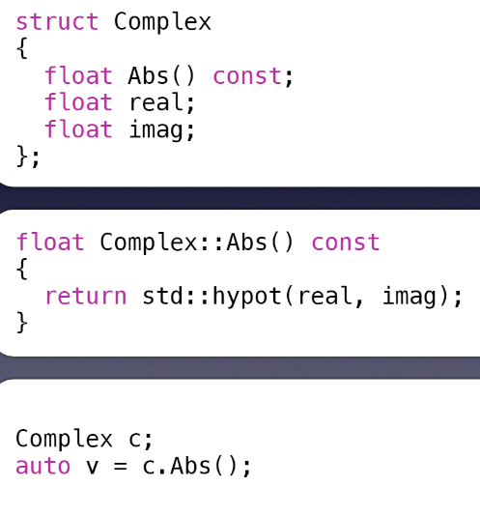
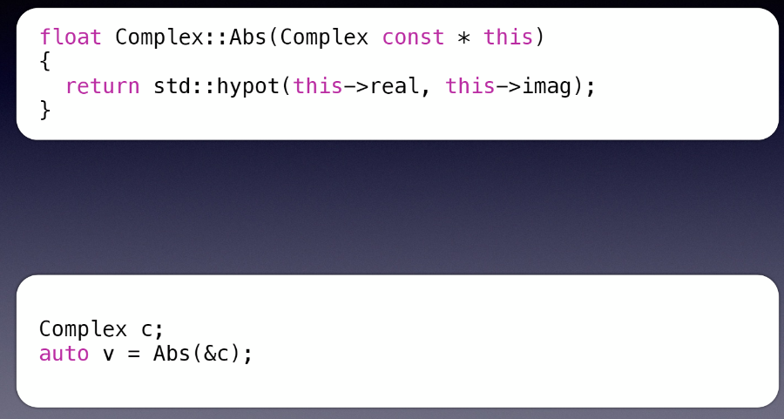
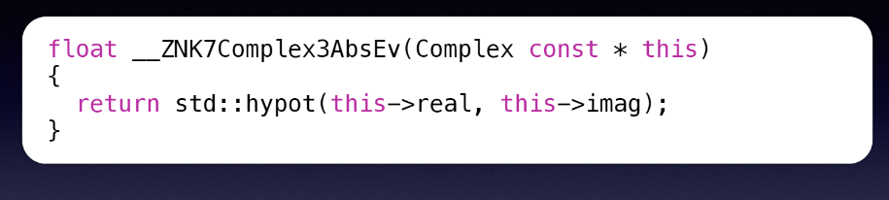
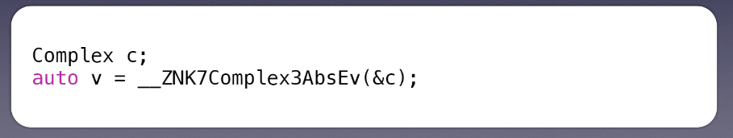

Slide 23
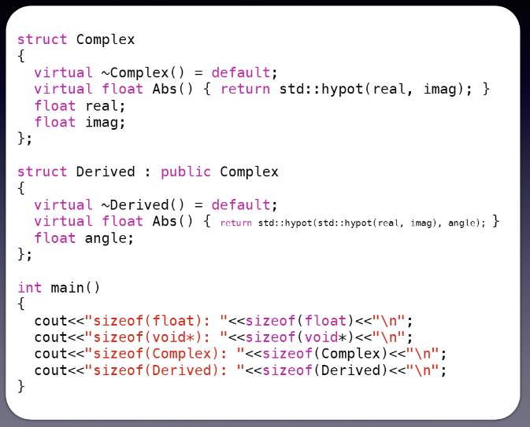
Notes:
Sizeof(Complex) = 16
Sizeof(Deriver) = 24

Slide 24
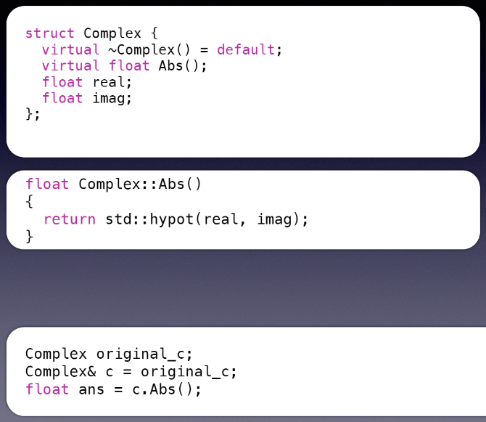
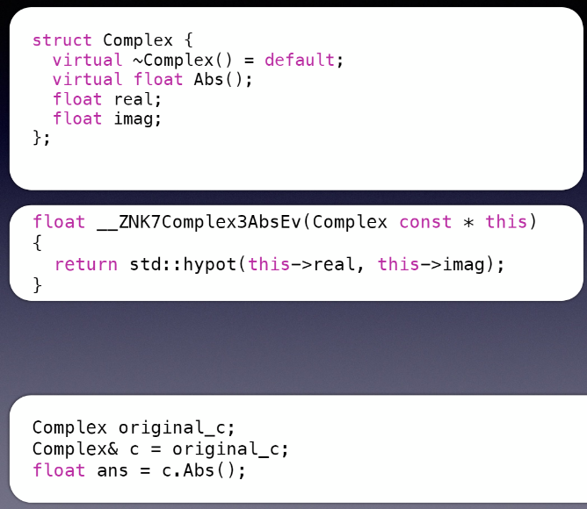
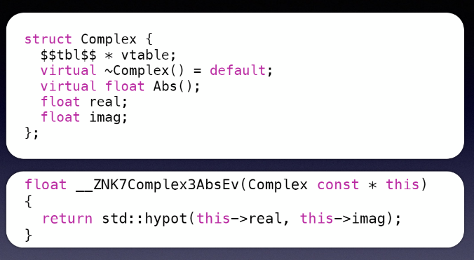
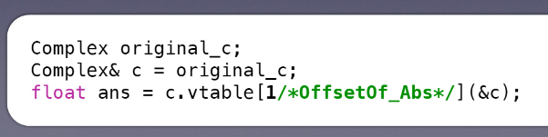

Slide 25
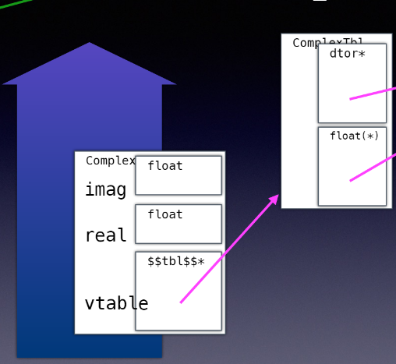
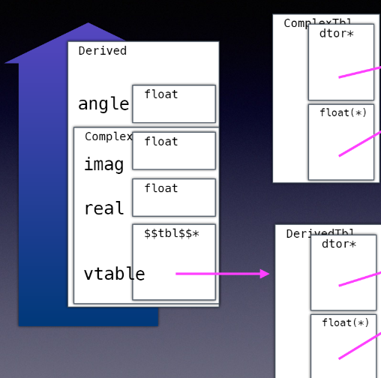

Slide 26
Functions
overloading
Operators
Operators vs class member operators

Slide 27
Operators
Operator+
Operator-
Opeartor++
Operator—
Operator<<
Operator()
Operator[]
Operator,
Notes:
Non-members function to make type conversions possible on all arguments
Function inside the class to have the proper function parameters automatically instantiated from the template
The only way to declare a non-member function inside a class it to make it a friend

Slide 28
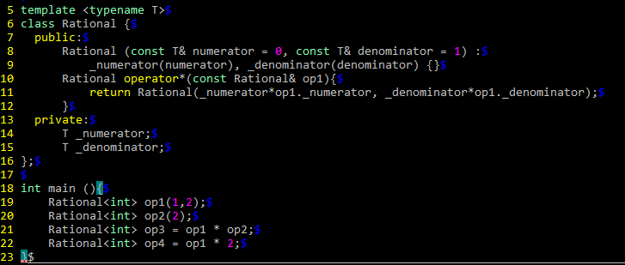
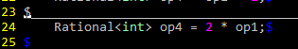
Classic example

Slide 29
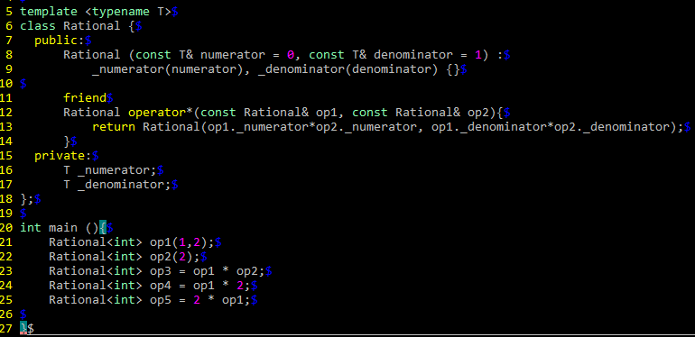
Solution

Slide 30
Homework
Search and list for known idioms, patterns, solutions for polymorphic containers
List daily work polymorphic designs

Slide 31
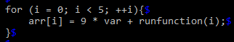
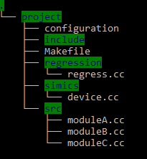
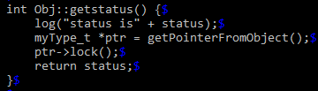
Naming

Slide 32
Files
Variables
Objects
Functions
Folders
Namespaces
Macros
Enums, typedefs, etc…
Notes:
Emulate the god particule and naming are one of the most changelings areas of programing

Slide 33
Scope
{
}

Slide 34
Global
Static
Local
Member
Namespace

Slide 35
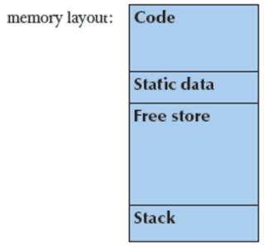
Memory Management

Slide 36
Stack memory
How to request stack memory?
Who manages this memory?
For which purpose is this memory?
Heap memory
How to request heap memory?
Who manages this memory?
Whats the difference between malloc and new?
For which purpose is this memory?
Notes:
Malloc reserves the memory from the HEAP without initializing the object
New reserves the memory from the FreeStore (HEAP) and calling the constructor of the object
The difference is in terms of implementation

Slide 37
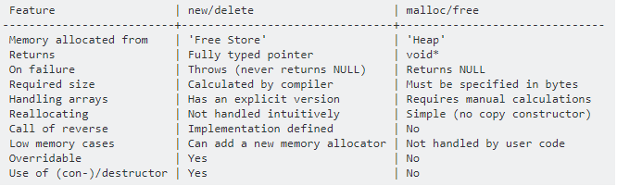

Slide 38
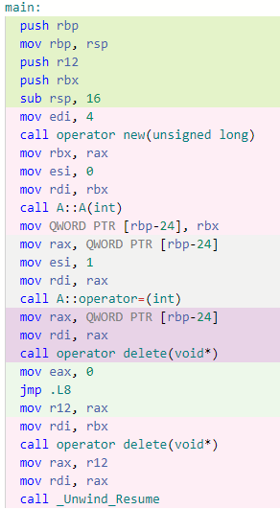
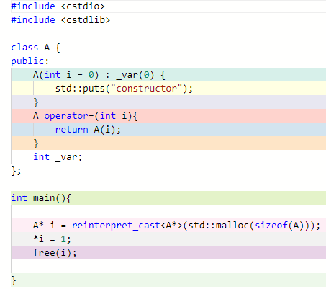
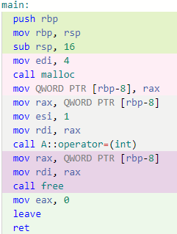
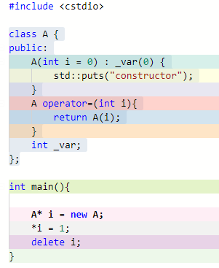
New vs Malloc

Slide 39
Homework
Create a program that takes all RAM until it crash
Can you do it without dynamic memory allocation?
Can you do it without stack memory allocation?

Slide 40
Reference vs Pointer

Slide 41
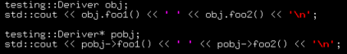
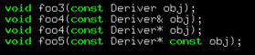
NULL
Implicit vs explicit access
Pass by value, pass by reference, pass by pointer

Slide 42
const

Slide 43
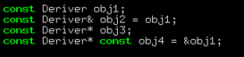
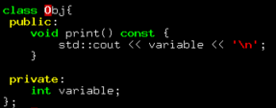
Use const proactively
Const objects
Const pointers
Const function members
Notes:
Use of const helps code to avoid initialized variables
Use of const is not really aimed for performance, it is meant to describe best the code

Slide 44
Google coding style guide
Standards? For what?
Notes:
Make people do wrong things harder, make people do right thigs easily
Write code understandable for the reader, not the writer

Slide 45
The logic should be straight forward to make it hard for bugs to hide,
the dependencies minimal to easy maintenance,
error handling complete according to an articulated strategy,
and performance close to optimal so as not to temp people to make the code messy with unprincipled optimizations.
Clean code does one thing well
Use Common Sense and BE CONSISTENT
- Bjarne Stroustrup

Slide 46
Links
Google coding style
Compiler Explorer to see assembly

Slide 47
References
Effective C++
C++ Coding Standards
https://en.cppreference.com/w/
CPPCON
c++ foundation

